Slide 1
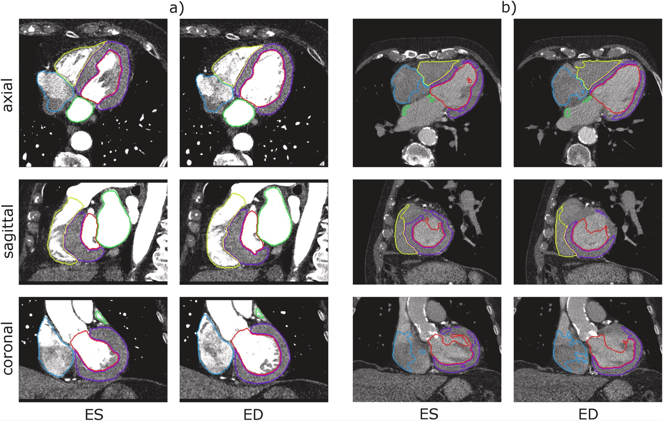
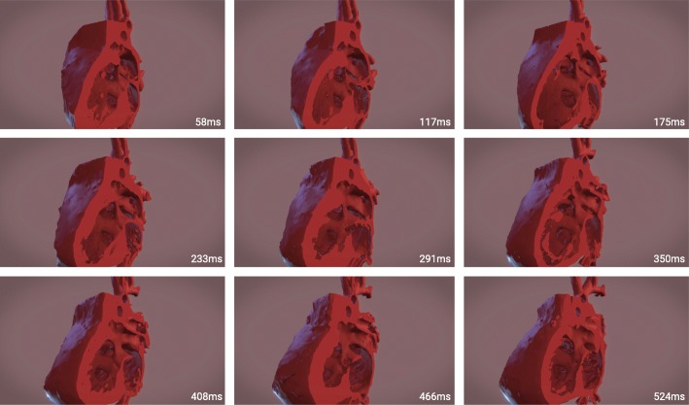
Toward Automation of a 4D Heart from Retrospectively Gated Cardiac CT Scans
Alex Hoerr, Jack Mordi, Johnathan Wells, Kidus Berhanu, Nina Fetene, Chandler Wesoloski, Noah Trillizio, and Rose Knecht
Bradley University and OSF
Abstract
Methods
Results
Conclusions
The concept of the 4D heart refers to a comprehensive, time-sequential representation of a beating heart, showcasing its progression from diastole to systole. This is achieved by creating a series of 3D models that accurately depict the heart's internal structures throughout its rhythmic cycle. Although modern medical imaging technologies, such as computed tomography (CT) and magnetic resonance imaging (MRI), have made it possible to generate detailed 3D data blocks during the cardiac cycle, visualizing the intricate intracardiac processes of a beating heart in 3D still requires segmenting the heart at each phase. This becomes particularly important in cases of dynamic cardiac pathologies, like hypertrophic obstructive cardiomyopathy, where a meticulously segmented 4D heart model can be instrumental in devising effective surgical strategies.
Currently, the process of segmenting these images is a laborious, manual task that involves carefully distinguishing the heart from other structures in the scan. Our objective is to streamline this process by automating myocardial wall segmentation throughout the entire cardiac cycle. To achieve this, we plan to create a machine-learning model capable of identifying the heart and generating accurate masks for the given CT images.
Once the segmentation is complete, we will utilize the machine-learning model's output to construct a 4D heart model that captures the heart's dynamic nature. By developing and refining these innovative heart modeling techniques, we aim to propel medical imaging technology to new heights, thereby enhancing diagnostic and surgical planning capabilities in the field of cardiology.
Machine Learning
For Machine learning we use a convolutional 3D image Neural Network for our model. The model is based on the paper Automatic whole-heart segmentation in 4D TAVI treatment planning CT. The model takes in a series of medical (nifti images) and trains to identify certain sections of the heart by using pre-identified images. During the testing phase our trained model will then be asked to identify the segments on new images. The neural network model will then produce new segmentation images of how it believes the heart should be segmented. Then by comparing the models predicted segmentation verses our own human made segmentations be can determine how accurate the automatic segmentation of the model is.
Training Data
In order to support the training of our model, we required training data. The type of data we needed was not as available as we would like for this project. This is in part due to the specific nature of the research and the legal issues of sharing patient information. To our luck, OSF was able to provide us with around 80 anonymized CT scans and premade heart models that would help us create the necessary data.
Using a program known as 3D Slicer, we were able to create the masks we needed to train our model. The program had the functionality to map out the shape of a 3D model of a heart onto its associated DICOM series. This provided us with accurate data that was generated by medical professionals, further improving the accuracy of our model.
The results of our project have been inconclusive so far, with multiple problems arising along the way. First, while generating the masks for our DICOM series, many of them were different sizes from each other and would provide difficulties when importing them into our model. This was resolved by padding the smaller images so that everything was a uniform size. Through this method, we were able to produce approximately 30 masks for our testing data.
The second major issue that we encountered was a computing problem. While multiple members of the team have powerful computers, due to issues with importing and file management we weren’t able to utilize them for training purposes. Furthermore, the environment we’ve been using provided by Google Colab was running into memory overflow issues that couldn’t be resolved. Due to both of these issues, we have yet to provide working results that generate a valid CT segmentation.
The final goal of this project is to generate a 4D model of the heart using these 3D generated images from our model. While this has not been achieved yet, the progress made on the 3D generated images has been crucial in this endeavor.
In conclusion, our goal is to be able to create a 4D model of a heart just from a set of CT images. By using advanced image registration and image segmentation algorithms, we can create detailed and accurate models that can greatly improve surgical planning and patient outcomes. Through combining multiple CT scans taken at different times, it is possible to create a dynamic 4D model that incorporates the heart's movements and changes over time. Our current progress has shown us that this goal is achievable and we anticipate that it will be completed by May, 2023. Our results thus far, while limited, give us a better understanding of current limits and how we need to proceed going forward.
Moving forward, we look to hone our current model by utilizing more powerful computers to resolve the memory overflow. We also wish to ensure the validity of our outputs through further testing. Finally, as our ultimate goal we want to implement a process for creating the 4D models to further aid medical practitioners.
Objectives
Myocardial Wall Segmentation
The first objective is to identify and segment the left and right Myocardial walls of the heart using a neural network AI. The AI will take in a series of medical image files (nifti) and produce new medical image files with the segmentations identified. The new medical image files must preserve the shape and metadata from the original images in order to successfully reconstruct a model
4D Heart Model
After running the medical images thought the Myocardial segmentation model, the images will be reassembled into a temporal 4D Model. The 4D model will display as a three dimensional model but holds the state of the model at multiple different points in time. Useful when trying to identify how the heart is beating.
References
Bruns, S., Wolterink, J. M., van den Boogert, T. P. W., Runge, J. H., Bouma, B. J., Henriques, J. P., Baan, J., Viergever, M. A., Planken, R. N., & Išgum, I. (2022). Deep learning-based whole-heart segmentation in 4d contrast-enhanced cardiac CT. Computers in Biology and Medicine, 142, 105191. https://doi.org/10.1016/j.compbiomed.2021.105191
Mena, K. A., Urbain, K. P., Fahey, K. M., & Bramlet, M. T. (2018). Exploration of time sequential, patient specific 3D heart unlocks clinical understanding. 3D Printing in Medicine, 4(1). https://doi.org/10.1186/s41205-018-0034-7
(1)
Acknowledgements
We’d like to acknowledge Dr. Sam Hawkins for his helpful and insightful guidance during this project. We would also like to recognize Dr. Matthew Bramlet and OSF for providing us with this opportunity and the training data used for this project.
(2)

